Slide 1
Hive

Slide 2
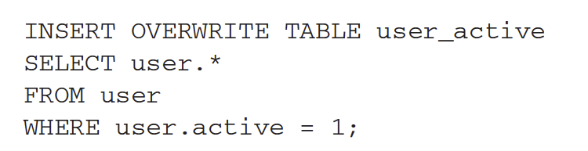
Hive
A data warehouse package built on top of the MapReduce framework of Hadoop
Began in Facebook
Now an open source subproject of Hadoop
Target users
Data analysts who want to write ad-hoc SQL queries over massive data sets.
Hive provides SQL-like language
E.g. to get all active users from a user table you write the following:
Hive was first introduced in the following paper:
Ashish Thusoo, Joydeep Sen Sarma, et. al.,Hive – A warehousing Solution Over a Map-Reduce Framework, VLDB 2009.

Slide 3
Hive
Big difference between Pig and Hive is that Hive requires the definition of a schema
Hive uses relational database concepts of tables, rows, columns.
Hive uses the important metastore to store schema information.
The metastore typically resides in a relational database
The query language used by Hive is called HiveQL

Slide 4
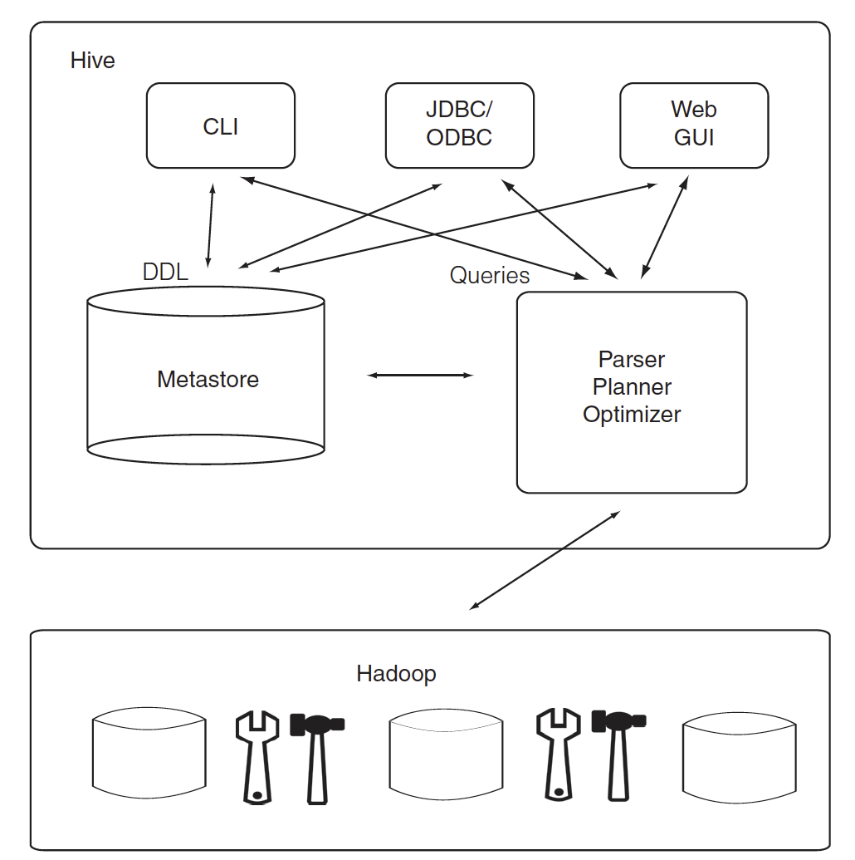
Hive Architecture
There are three ways of interacting with Hive
Web GUI
Java Database Connectivity (JDBC)
Command line interface (CLI)
The most popular way.
Queries are parsed and executed on Hadoop
The metastore stores the table schema and other metadata
It is important in determining how queries will be run.
The metastore is a single point of failure.
Need to make sure data can be recovered or use high availability by replicating the database.

Slide 5
Schema on Read
In traditional databases the database has total control of the data.
They can enforce the schema as data is written.
The data is written in a way that conforms to the schema
E.g. if a value is supposed to be an integer than the database will make sure an integer is written out.
Hive has no such control on the data
Hive can only enforce schema on read
Schema on read
Hive does its best to read the data to conform to the schema
Sometimes it needs to put in many null values for data that do not conform to the schema.
Eg. There are not enough fields in each record that match the schema
E.g. A nonnumeric string is found when it expects an integer.

Slide 6
Schema on Read Versus Schema on Write
Schema on read is much faster for initial load
No need to parse data and serialized it to disk in DB internal format first
Load operation is just a file copy or move
Or it is even possible directly reference the external file (stored on HDFS) without copying or moving anything.
Schema on read is more flexible
You can have two schemas for the same underlying data
In contrast
Schema on write makes query performance faster
Encode data in a more efficient way
Compression
Schema on write takes longer to load data into the DB.
Sometimes the schema is not known at load time since queries have not been formulated yet.
Hive is good for these situations.

Slide 7
Interactive Querying
Hive is not for interactive querying.
Too slow for that.
For large datasets often we need to write a query and wait hours for the answer.
For interactive SQL querying on Hadoop we need to use other tools
Presto
Impala
SparkSQL
Provides Hive interface
We will cover these later

Slide 8
Runtime modes
Like MapReduce, Hive can run in the following modes
Local
Pseudo distributed
Distributed

